Slide 1
Boosting Alogorithms

Slide 2
What is boosting?
Ensemble learning technique(combination of machine learning algorithm)
How Boosting Works?
Create the initial weak learner(individual algorithm).
Use the weak learner to make predictions on the entire dataset.
Compute the prediction errors.
Incorrect predictions are assigned more weight.
Build another weak learner aimed at fixing the errors of the previous learner.
Make predictions on the whole dataset using the new learner.
Repeat this process until the optimal results are obtained.
The final model is obtained by weighting the mean of all weak learners.

Slide 3
Adaboost
Works by fitting one weak learner after the other.
Gives more weight to incorrect predictions and less weight to correct.
Helps in predicting difficult classes
Final prediction by majority class or sum.
Used in both classification & regression

Slide 4
XGboost
Gradient boosting algorithm(uses decision trees)
Use weak regression tree as weak learners
Does cross validation
Accepts sparse input data

Slide 5
LightGBM
Faster and more memory efficient
Suitable for large dataset
Tree based gradient algorithm
Uses leaf wise tree growth and not depth wise
Will deal with null values

Slide 6
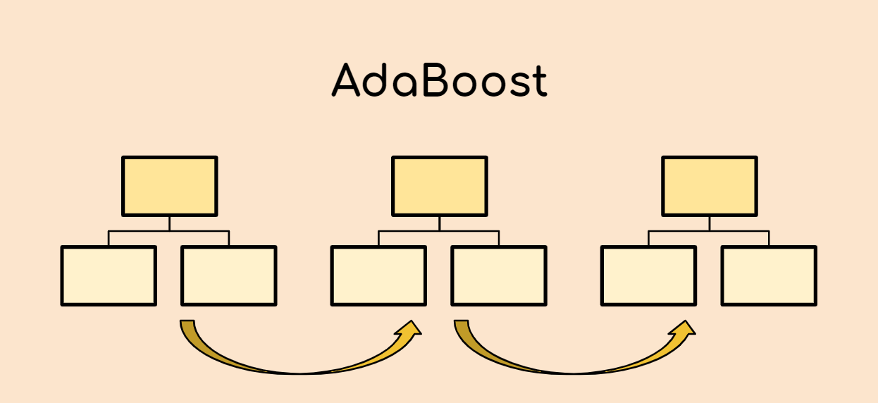
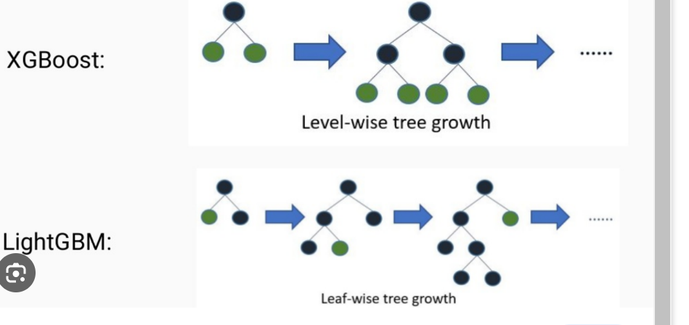

Slide 7
Thank you

